Slide 1
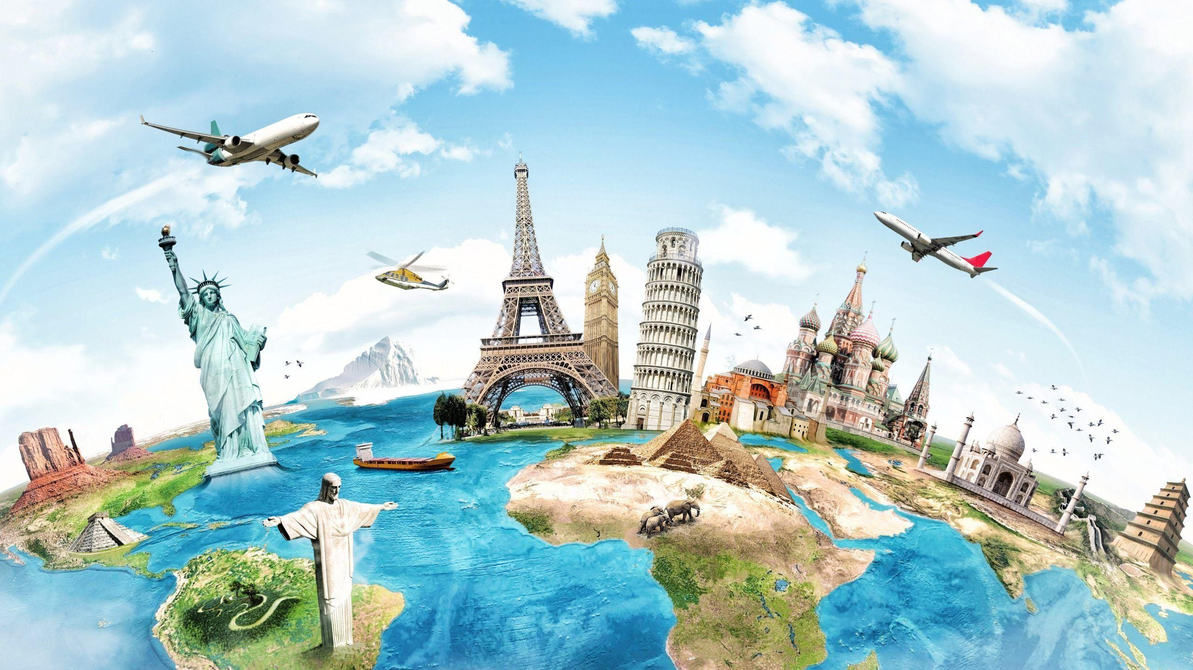
WORLD wish list
Countries that are worth to visit

Slide 2
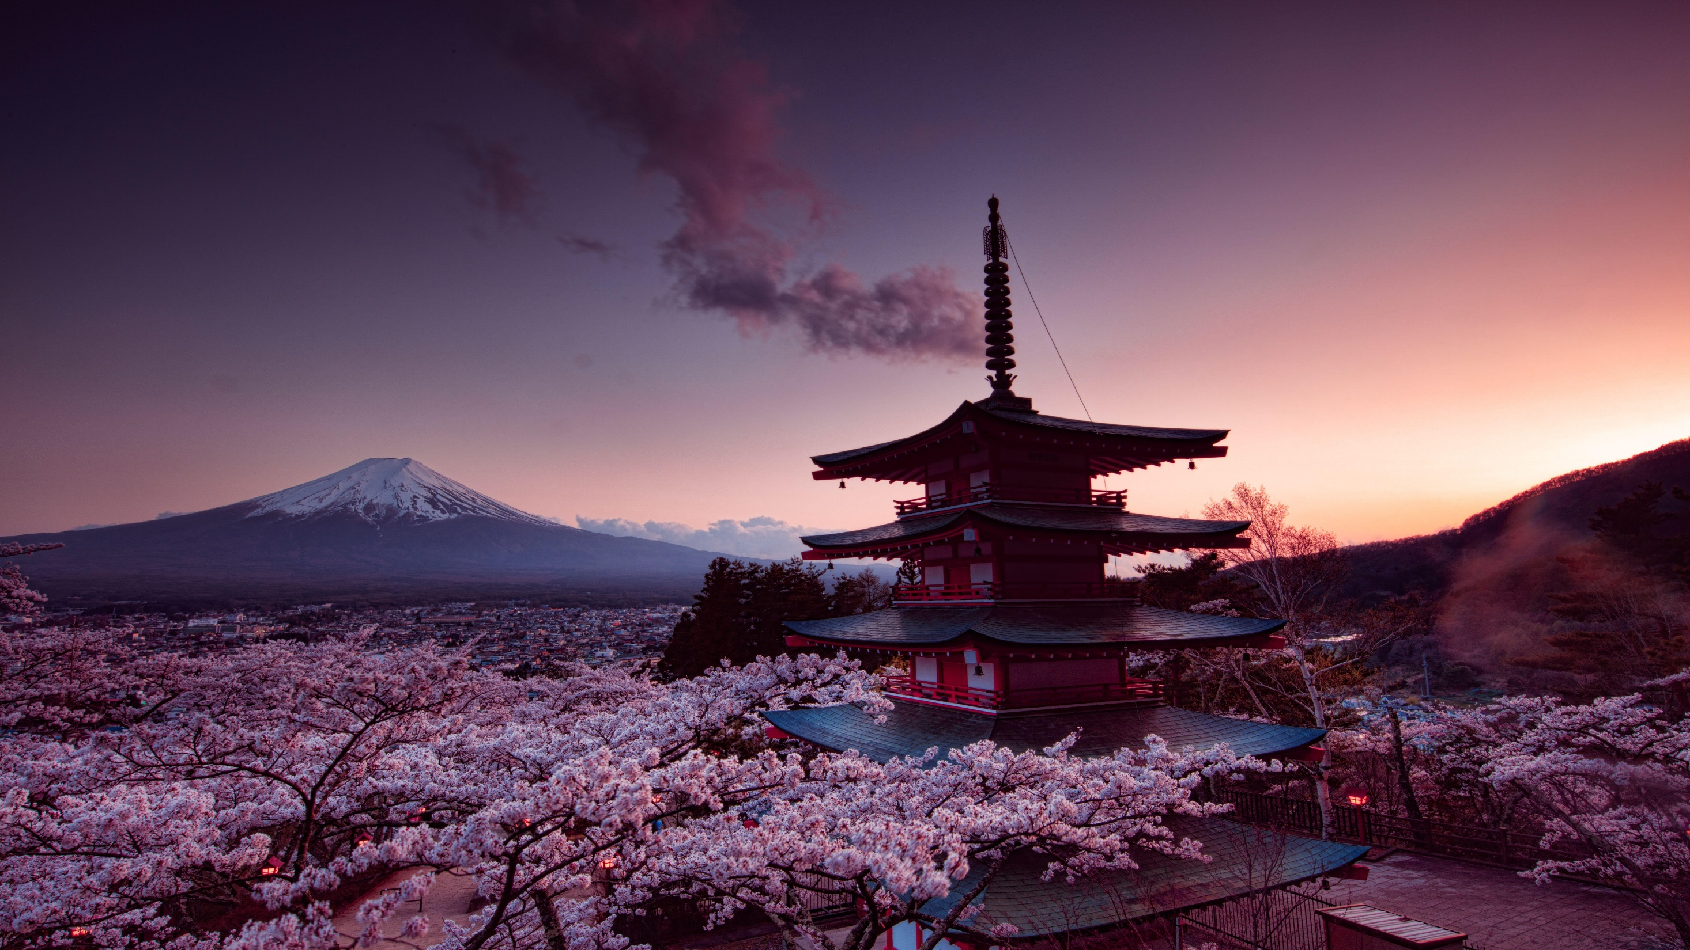
JAPAN
Capital: Tokyo
Currency: Japanese Yen
Language: Japanese
Known for its blend of ancient traditions and cutting-edge technology.
Famous for cherry blossoms, sushi, and Mount Fuji.
Japan is a global leader in robotics and electronics. The country values discipline, innovation, and nature.

Slide 3
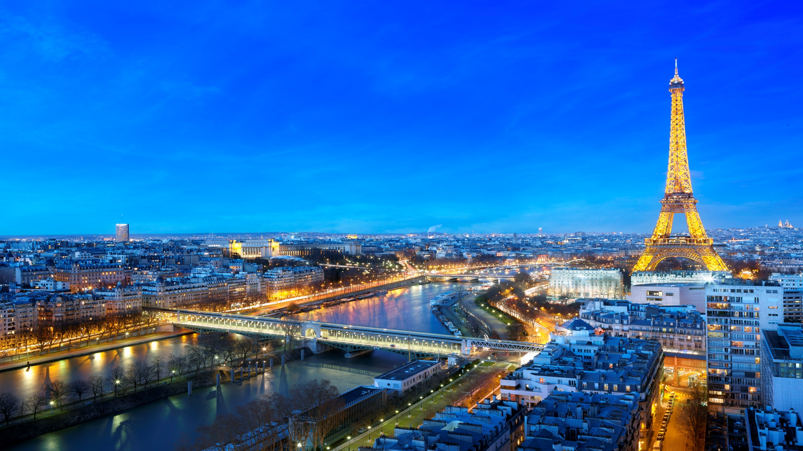
FRANCE
Capital: Paris
Currency: Euro
Language: French
Popular for fashion, cuisine, and iconic landmarks like the Eiffel Tower.
France has a rich history and deep influence in art, literature, and philosophy. Paris is known as the "City of Light."

Slide 4
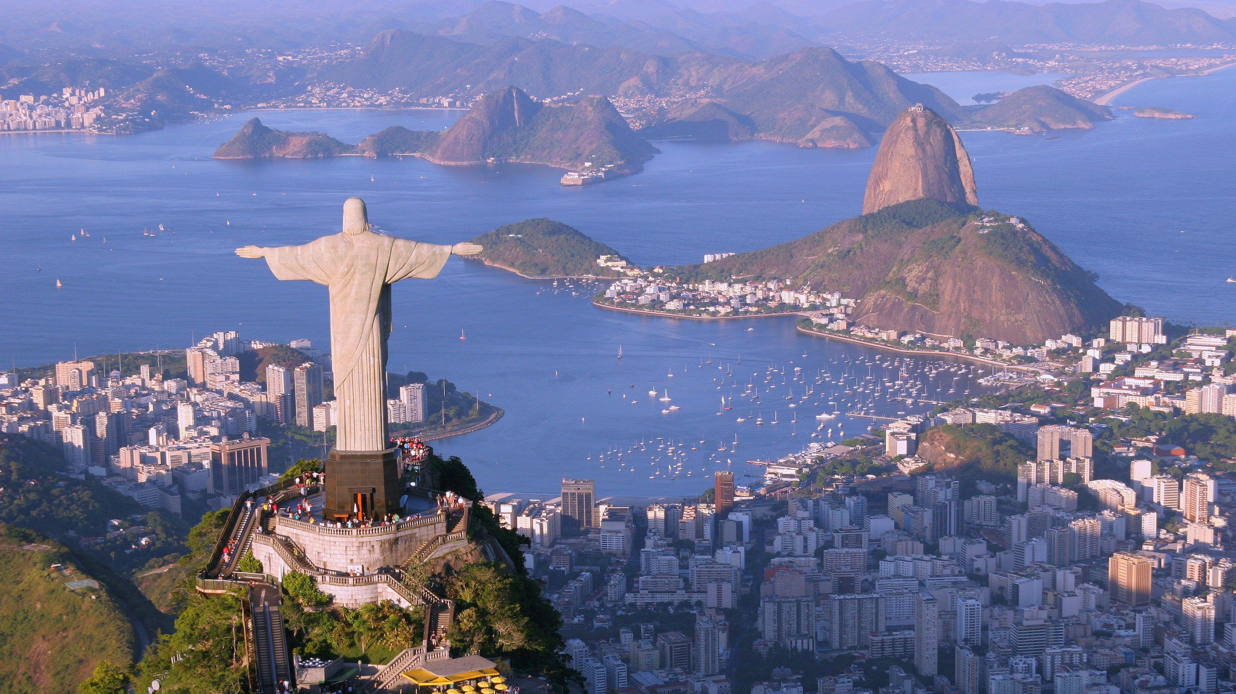
BRAZIL
Capital: Brasília
Language: Portuguese
Currency: Brazilian Real
Largest country in South America, home to the Amazon Rainforest.
Brazil is known for its vibrant culture, football passion, and colorful festivals like Carnival.

Slide 5
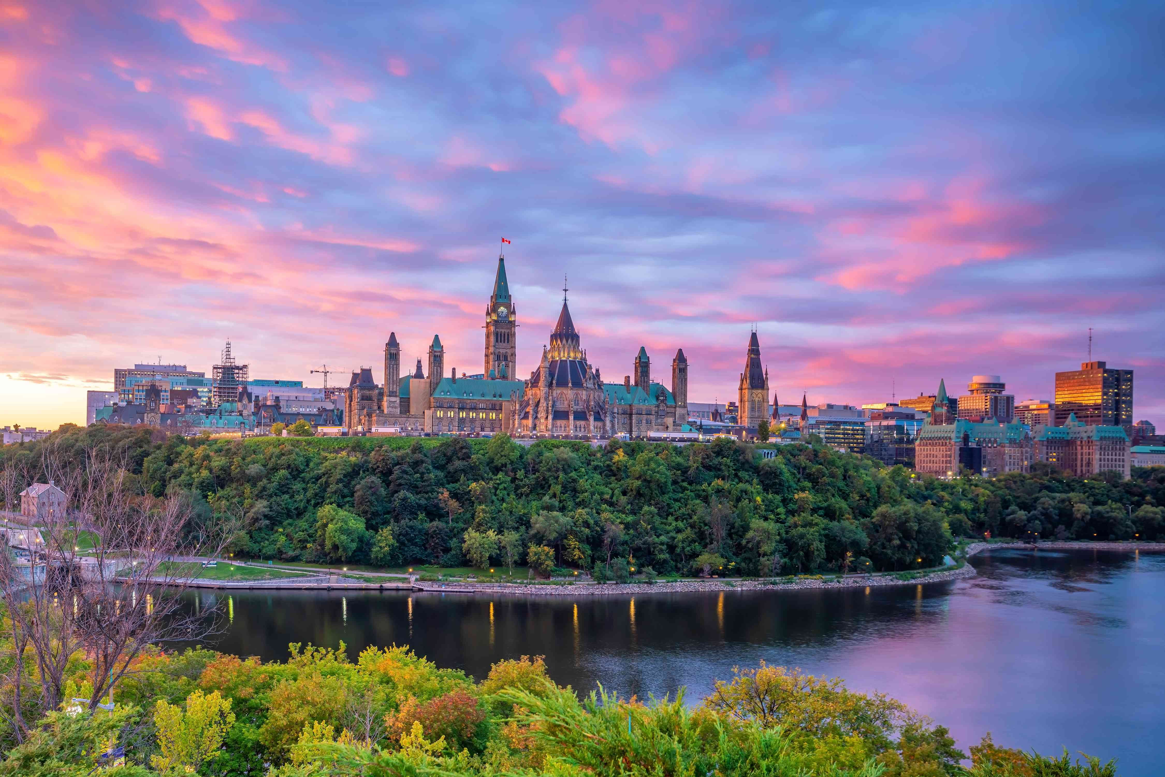
CANADA
Capital: Ottawa
Language: English & French
Currency: Canadian Dollar
Known for natural beauty—lakes, forests, and mountains.
Canada ranks high in quality of life and is famous for politeness, maple syrup, and multicultural cities like Toronto and Vancouver.

Slide 6
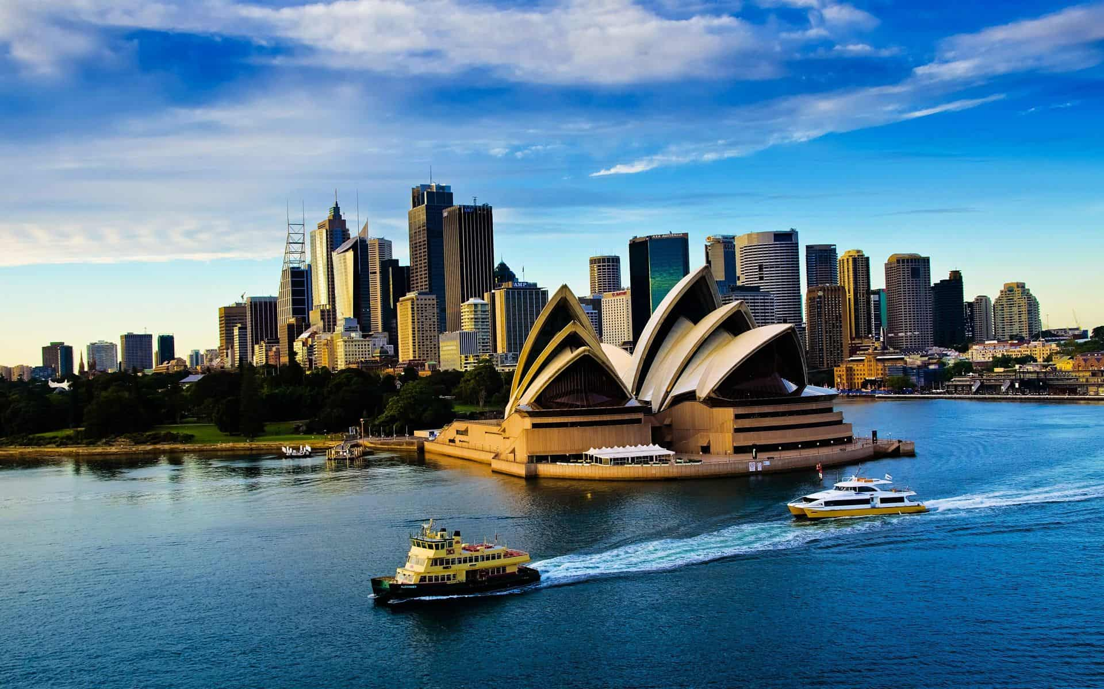
AUSTRALIA
Capital: Canberra
Language: English
Currency: Australian Dollar
Iconic landmarks include the Sydney Opera House and Great Barrier Reef.
Australia's laid-back culture, unique wildlife, and vast outback make it a top destination.

Slide 7
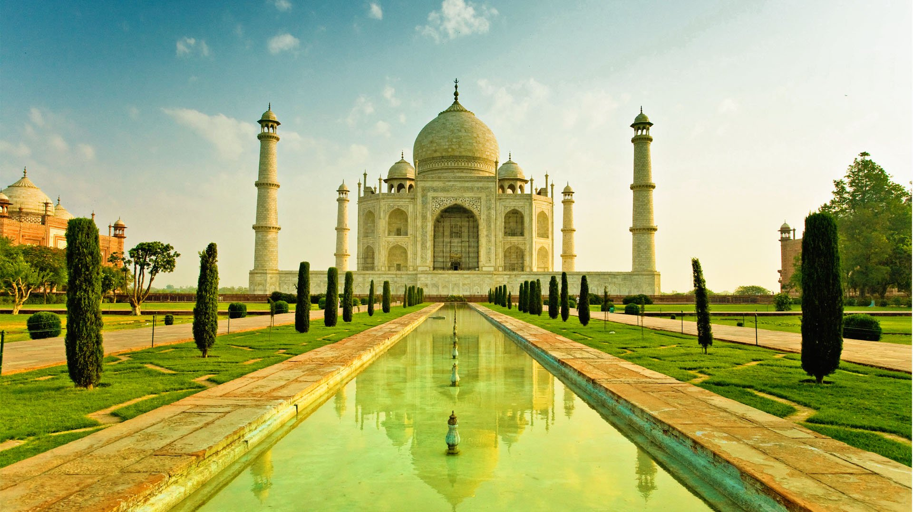
INDIA
Capital: Delhi
Language: Hindi
Currency: Indian rupee
World's largest democracy with deep cultural diversity.
From the Taj Mahal to Bollywood, India is known for its rich traditions, spirituality, and IT industry.

Slide 8
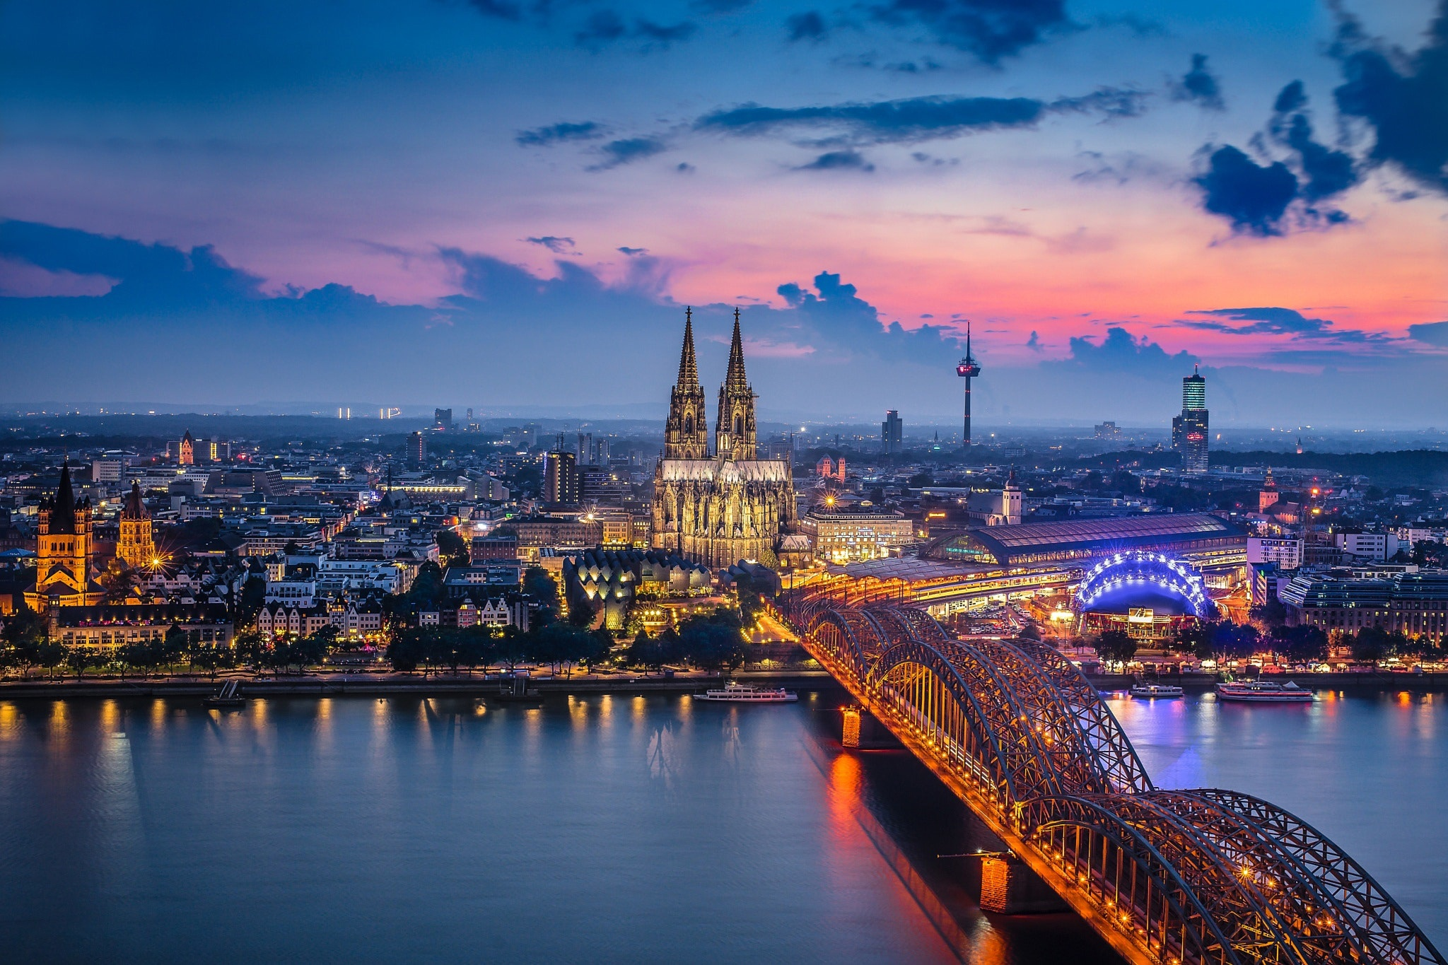
GERMANY
Capital: Berlin
Language: German
Currency: Euro
Europe’s economic powerhouse, known for engineering and precision
Germany is famous for Oktoberfest, castles, and contributions to science and philosophy.

Slide 9
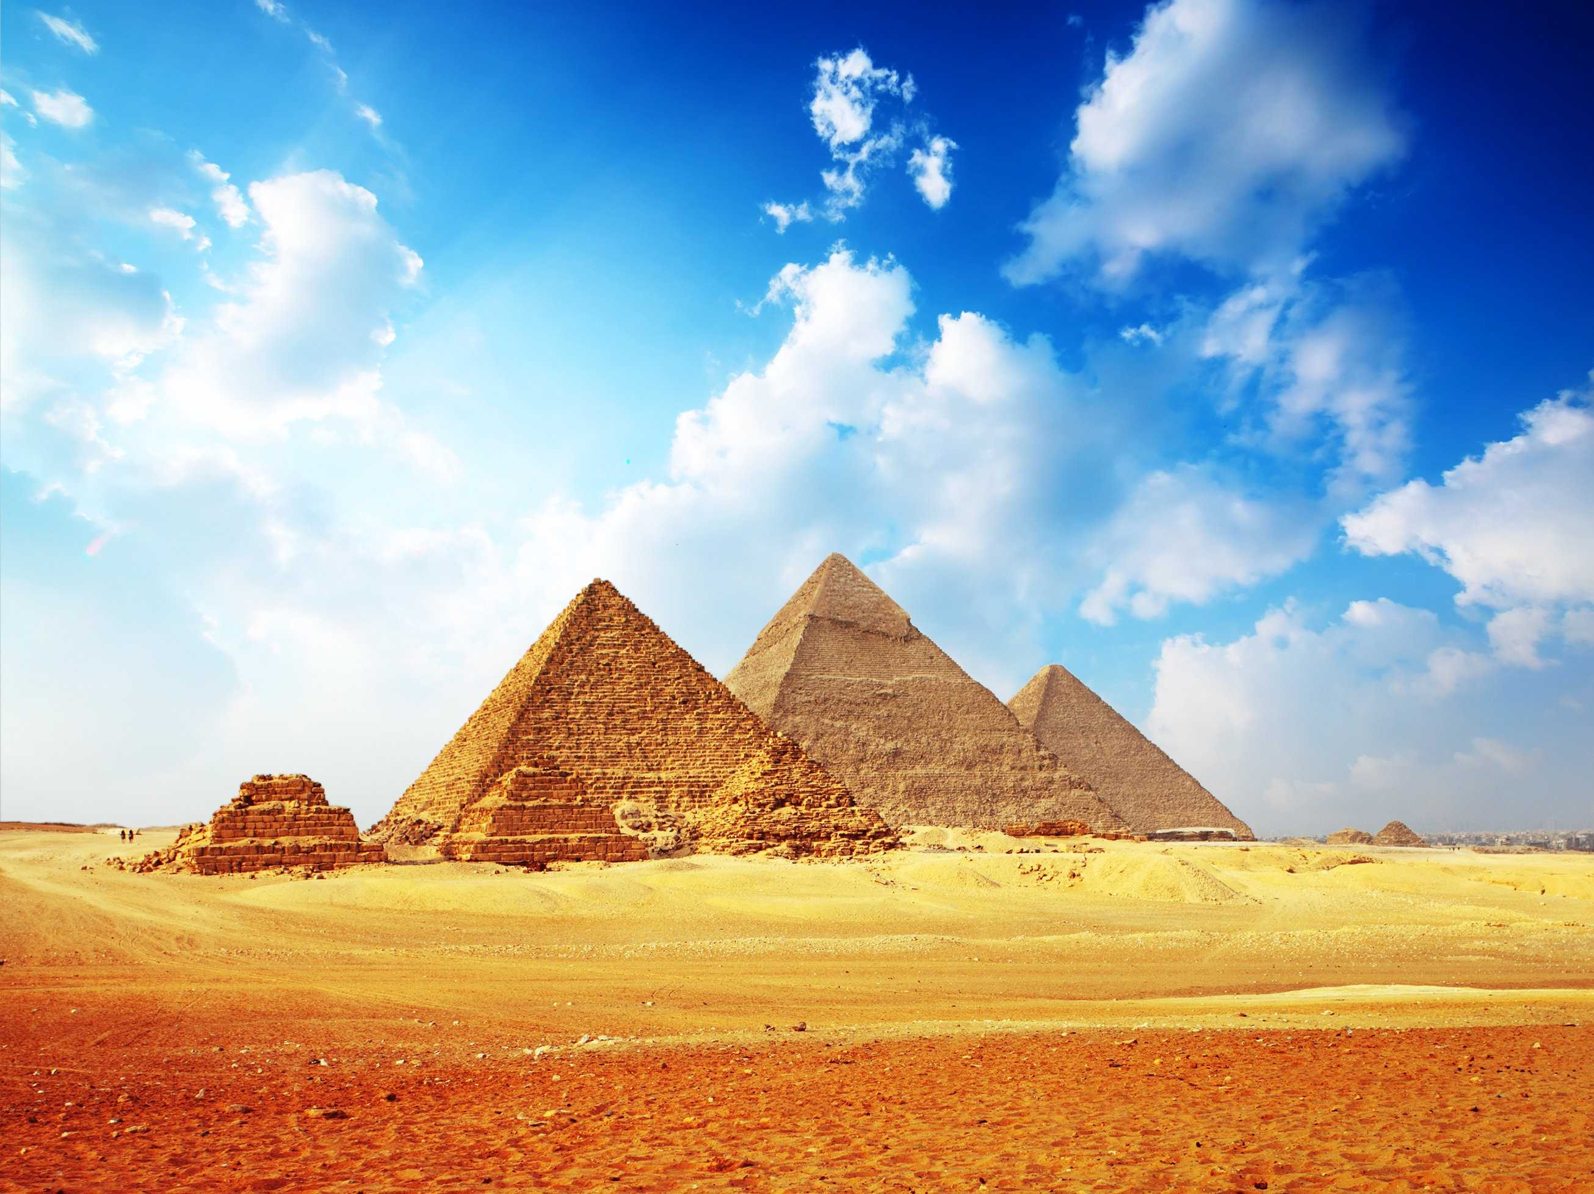
EGYPT
Capital: Cairo
Language: Arabic
Currency: Egyptian Pound
Home to one of the world's oldest civilizations.
The Pyramids of Giza and the Nile River are major attractions. Egypt has a deep connection to ancient history and archaeology.

Slide 10
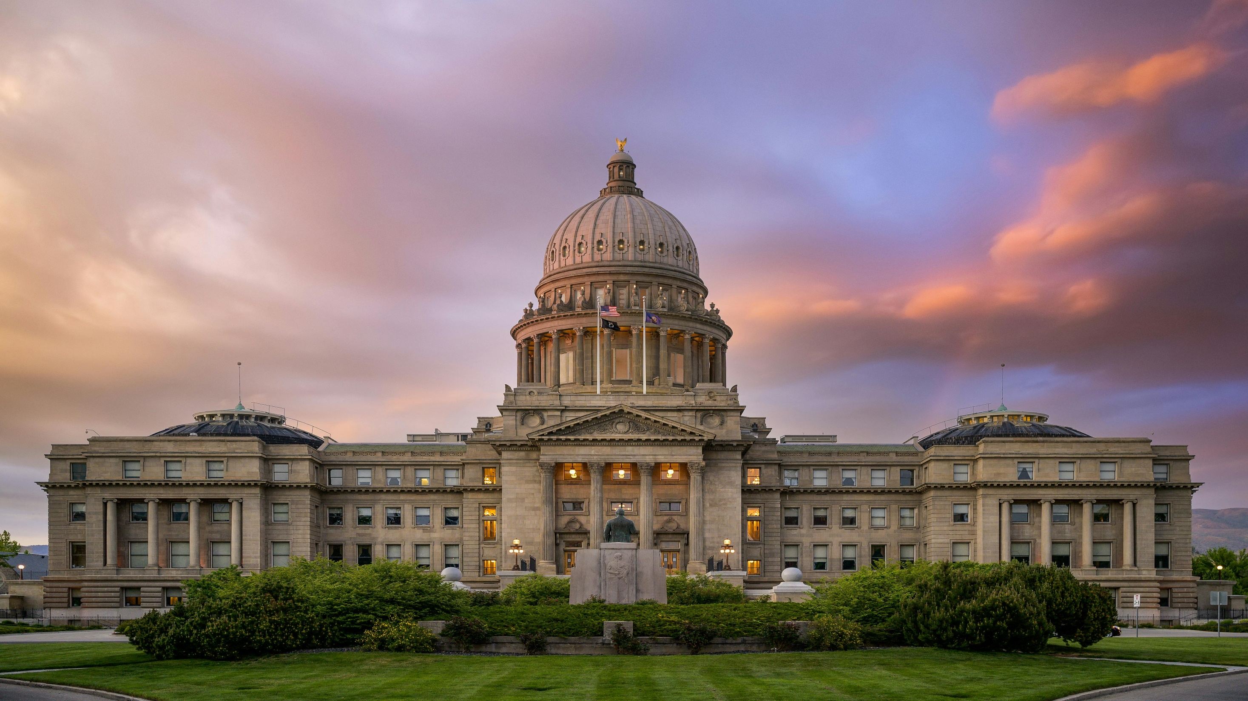
UNITED STATES
Capital: Washington, D.C.
Language: English
Currency: US Dollar
Known for its global influence in entertainment, tech, and politics.
A land of diversity and opportunity, the USA is home to Hollywood, Silicon Valley, and world-class universities.

Slide 11
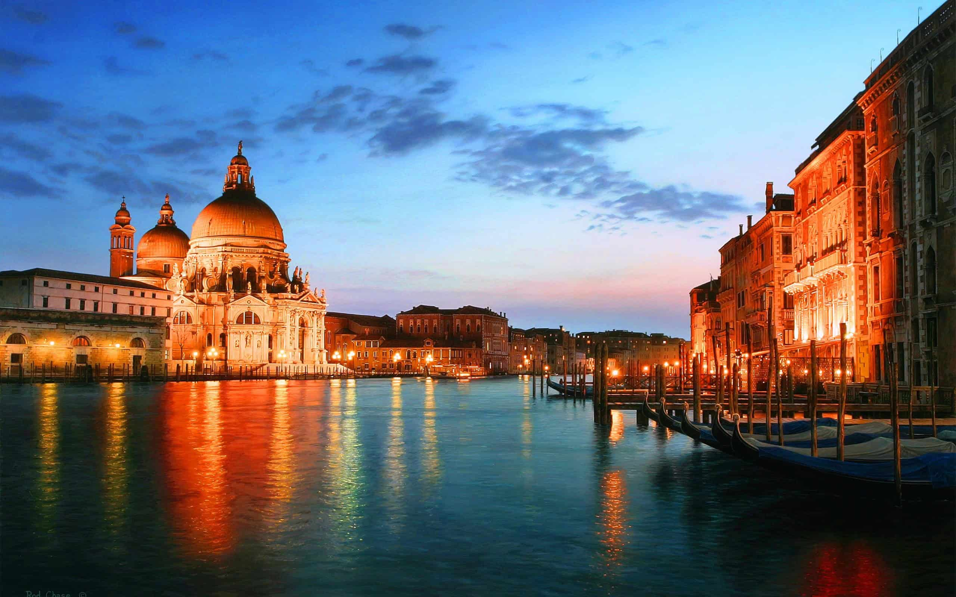
ITALY
Capital: Rome
Language: Italian
Currency: Euro
Renowned for art, architecture, and cuisine.
Italy has given the world pizza, pasta, and Renaissance masterpieces. Rome and Venice are top travel destinations.

Slide 12
SOUTH AFRICA
Capital: Pretoria (administrative)
Languages: 11 official, including English, Zulu
Currency: South African Rand
Known as the "Rainbow Nation" for its diverse culture.
South Africa offers wildlife safaris, Table Mountain, and a unique mix of African and European heritage.

Slide 13
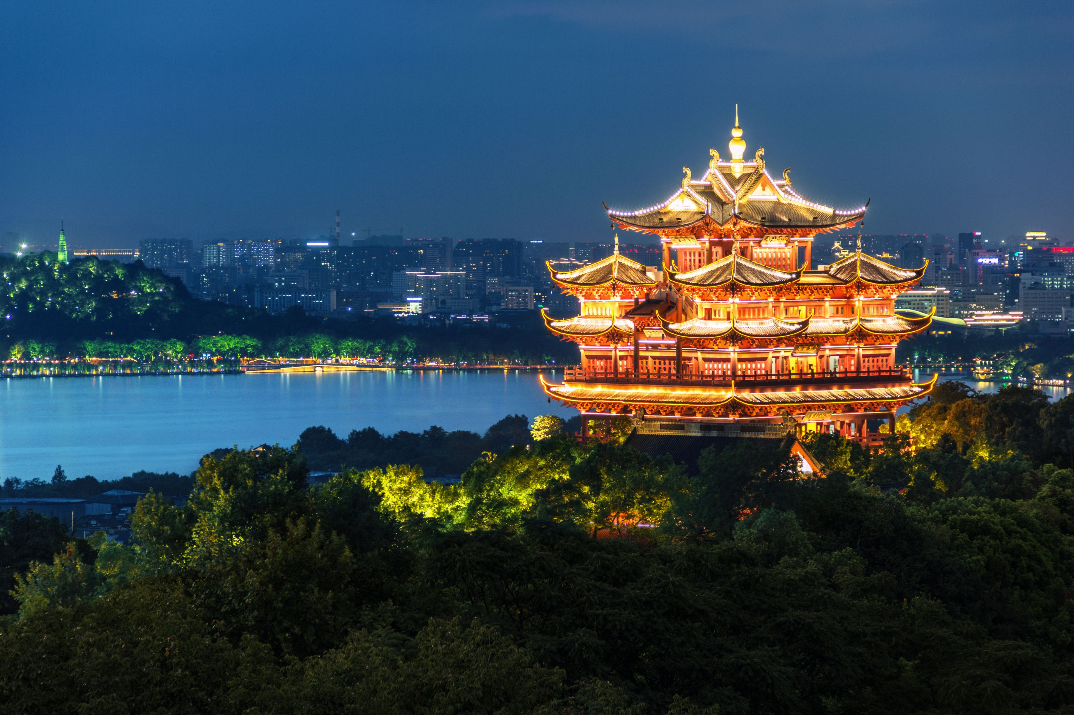
CHINA
Capital: Beijing
Language: Mandarin
Currency: Chinese Yuan (Renminbi)
One of the oldest civilizations and fastest-growing economies.
China blends tradition (like the Great Wall) with modern cities like Shanghai. It plays a key role in global trade.

Slide 14
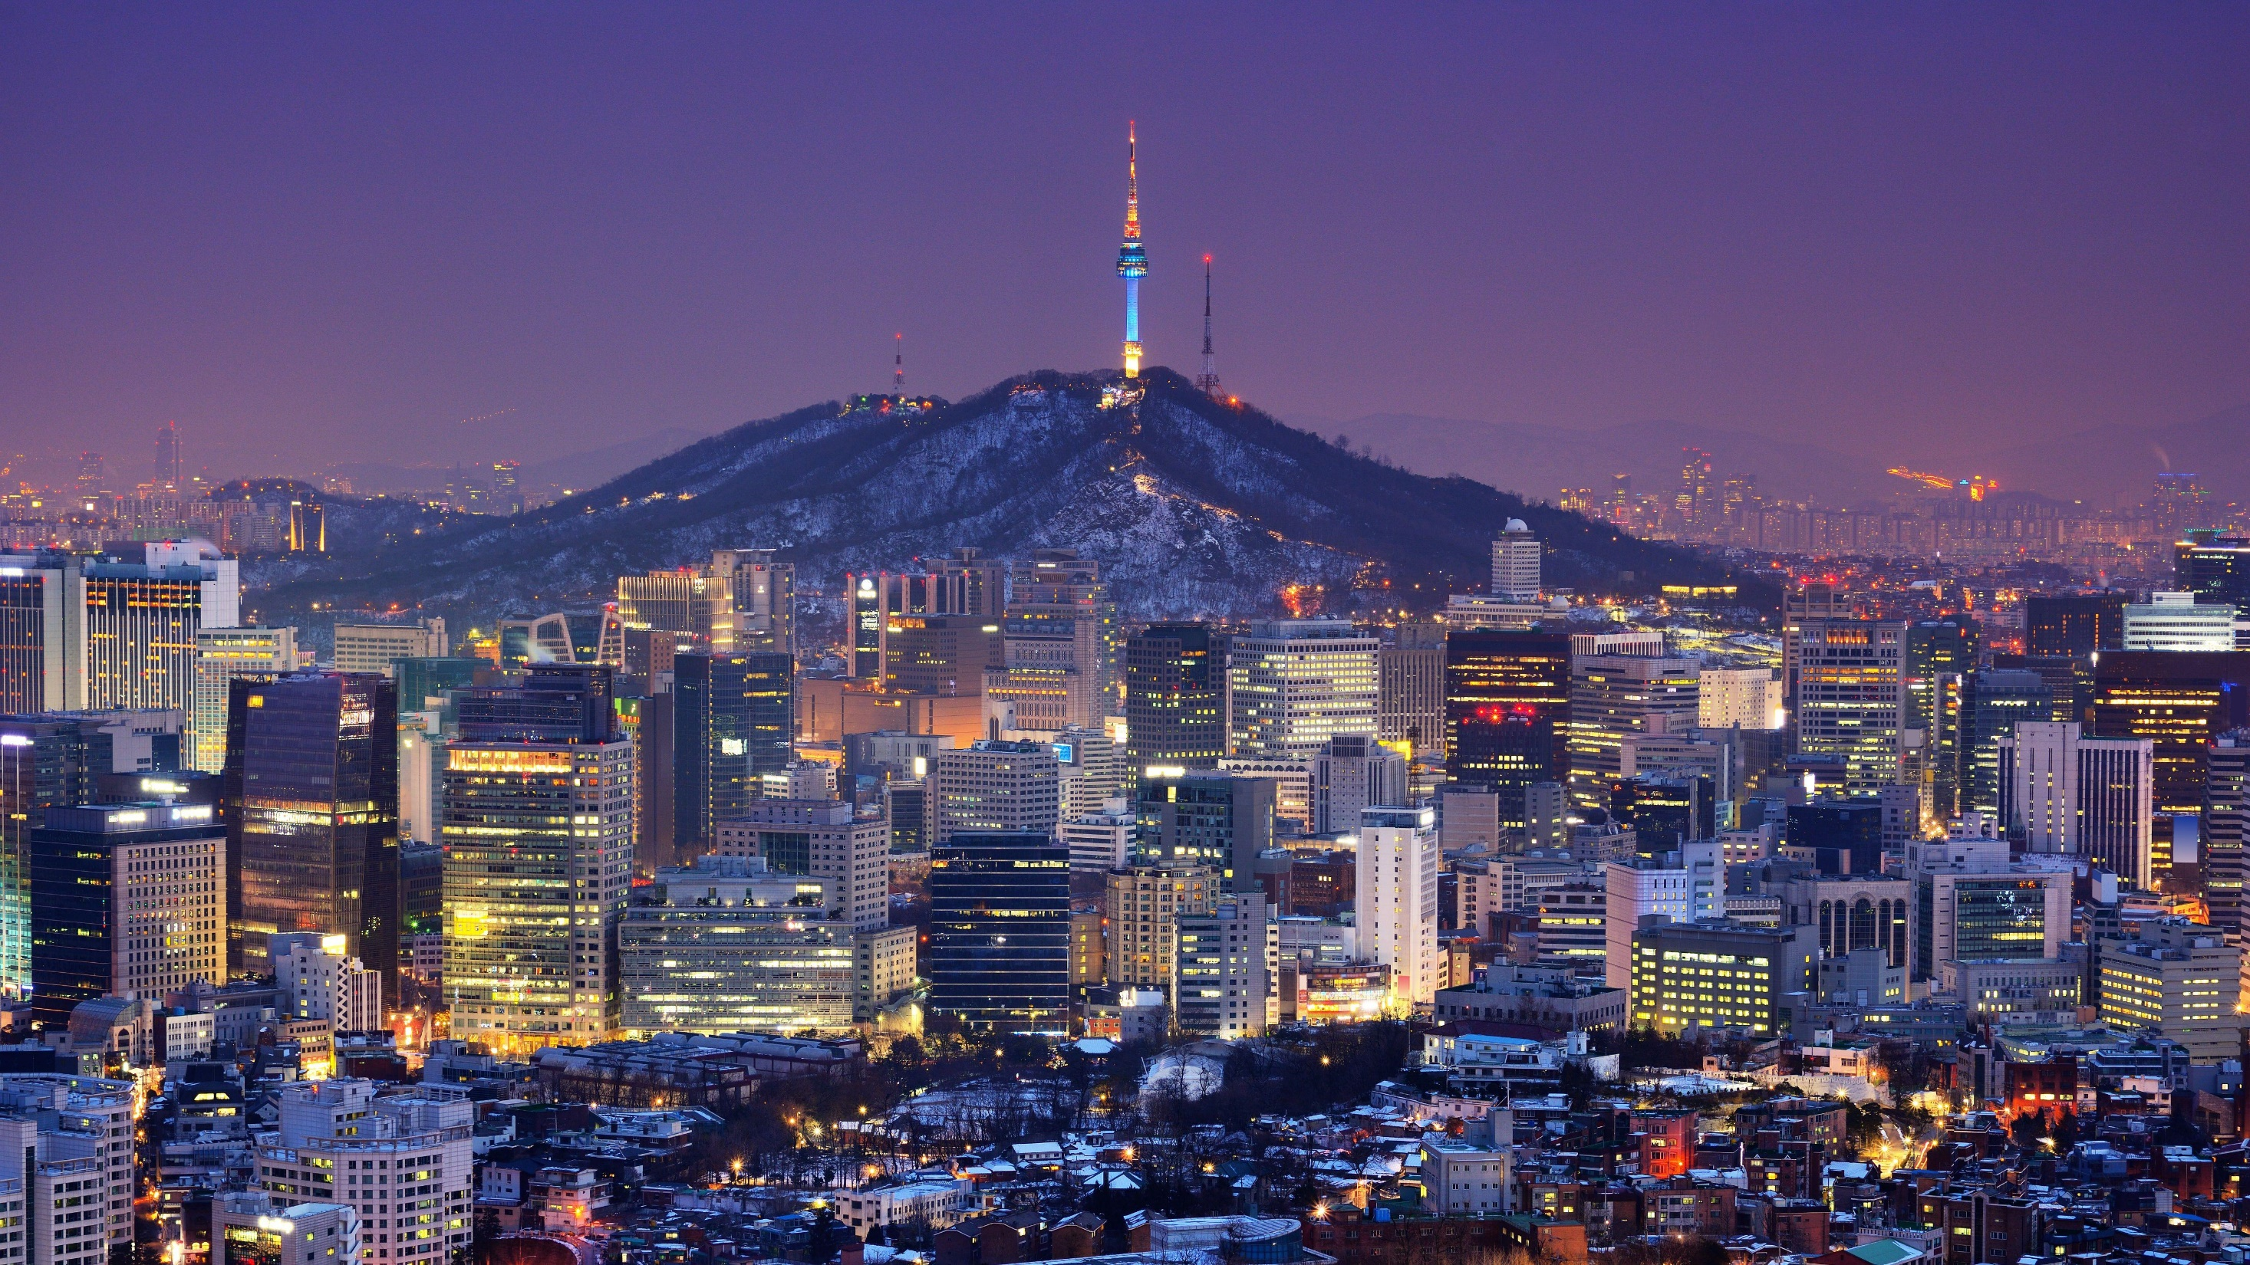
SOUTH KOREA
Capital: Seoul
Language: Korean
Currency: South Korean Won
A tech-savvy nation with a booming pop culture.
South Korea is famous for K-pop, Korean dramas, and companies like Samsung and Hyundai.

Slide 15
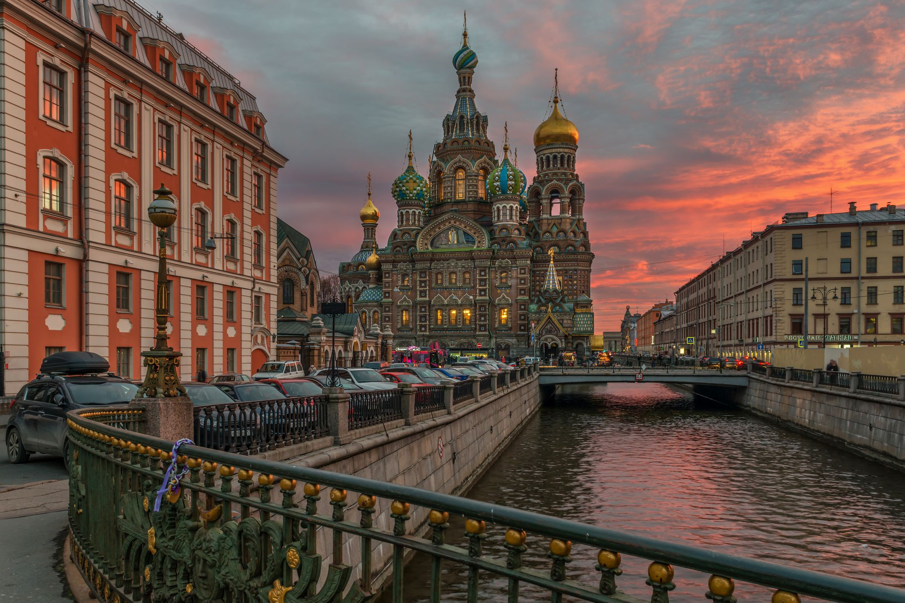
RUSSIA
Capital: Moscow
Language: Russian
Currency: Russian Ruble
Largest country by land area.
Known for its literature, space achievements, and dramatic landscapes from tundra to forests.

